Slide 1
Artificial Intelligence for Network Traffic Management
Assessment 3 Co-1 technical presentation
KAVINILAVU S
192565038

Slide 2
Introduction
What is Network Traffic Management?
1.Network traffic management controls the flow of data across network.
2.It ensures efficient use of network resources.
3.Traditional methods use fixed rules and manual configurations.
4.Artificial Intelligence (AI) makes traffic management smarter by learning network patterns and making automatic decisions.

Slide 3
How AI Works in Network Traffic Management
1. Network Traffic
2. Collect Network Data
3. AI/ML Analysis
4.Traffic Prediction
5. Automatic Routing & Resource Allocation
6.Improved Network Performance
AI Techniques Used
Machine Learning (ML)
Deep Learning (DL)
Predictive Analytics

Slide 4
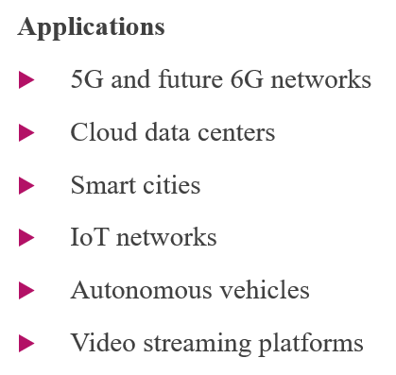
Advantages and Applications
Advantages
Reduces network congestion
Improves bandwidth utilization
Detects anomalies and cyber threats
Enables faster fault detection
Supports real-time decision making

Slide 5
AI and the OSI Model
OSI Layer | AI Contribution
Application | Improves application performance
Transport | Optimizes traffic flow and congestion control
Network | Intelligent routing and path selection
Data Link | Detects transmission errors
Physical | Predicts link failures and signal degradation

Slide 6
Conclusion
AI is transforming modern network management.
It predicts congestion before it occurs.
It automatically optimizes routing and bandwidth usage.
AI improves security, reliability, and Quality of Service (QoS).
It is a key technology for future networks such as 6G, IoT, and cloud computing.

